Slide 1
Bond Digital Health
TRANSFORM® Client use case
*COVID result app, dashboard display & checkpoint passport

Slide 2
Client’s aims and goals
This particular client wanted to achieve these things:
Differentiate their COVID-19 diagnostic product by adding digital data capture & management.
Add value to their customers in the private and public health sectors who were looking for a test with integrated digital tracking.
Pull all test data and epidemiological information into one place to produce a more complete picture.
Win more business and generate new revenue.
They knew they had to digitise their offer but didn’t know where to start.
The following slides illustrate how we made their rapid COVID-19 test better with data to help them achieve their business objectives.

Slide 3
Example of TRANSFORM® in action
Sona Connect™ enables users of Sona Nanotech’s lateral flow, rapid antigen test to capture and record test results and report additional data such as symptoms and underlying health conditions. The information is instantly uploaded to the secure Sona Connect™ cloud dashboard for reference and analysis by appropriate stakeholders.
Sona Connect™ is powered by Transform®. Bond’s powerful, user-facing platform allows diagnostic test developers to capture, digitise, visualise and share geo-mapped result data in real-time.
Primary functions :
Record test results - Once results are ready, take a photo of the results window of the test strip using the app and choose ‘positive’, ‘negative’ or ‘inconclusive’ from the dropdown options.
Enter subject data (Optional) - Record information about the subject such as photo ID, contact information, age, sex, underlying health conditions and symptoms to better inform epidemiology.
Upload, Share & Display - Submitting the result automatically uploads data to a secure cloud dashboard, which stakeholders can access, view and analyse the geo-mapped results.
Generate “Checkpoint” QR pass code with photo identification (Optional) - This can be utilised by security staff or by automated access systems.

Slide 4
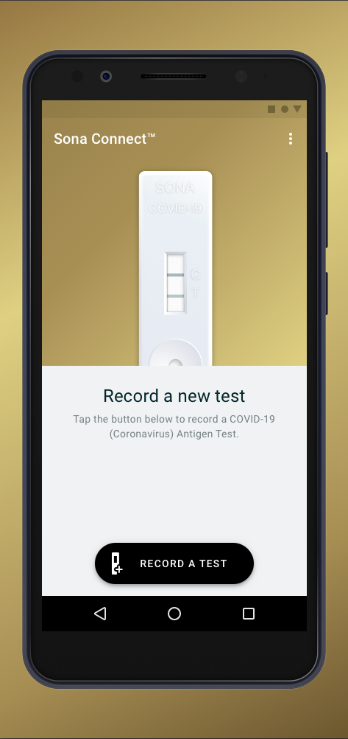
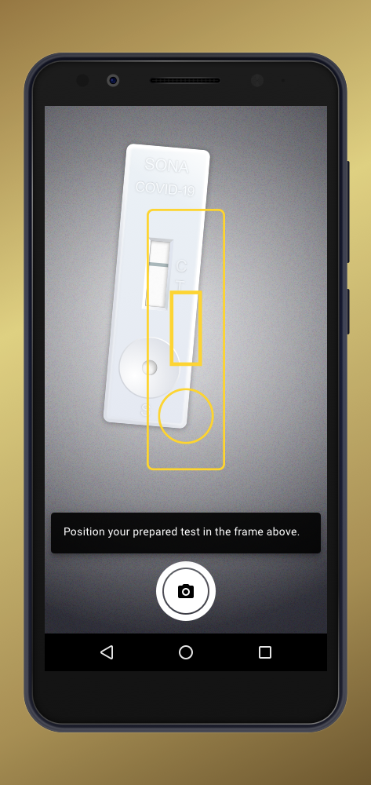
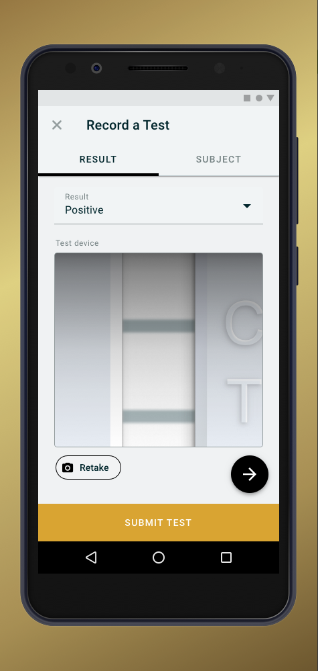
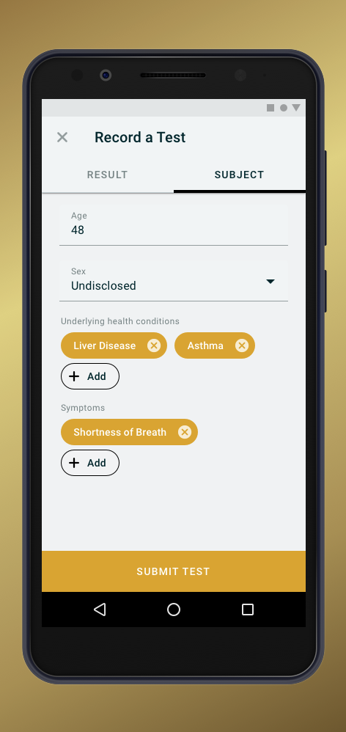
Android / iOS App Interface
Simple user interface to assist users while performing the test to reduce human error and increase accuracy & validity.
Adding value to epidemiologists and public health by capturing accurate test, subject and environmental data.
Displaying results for instant user feedback.

Slide 5
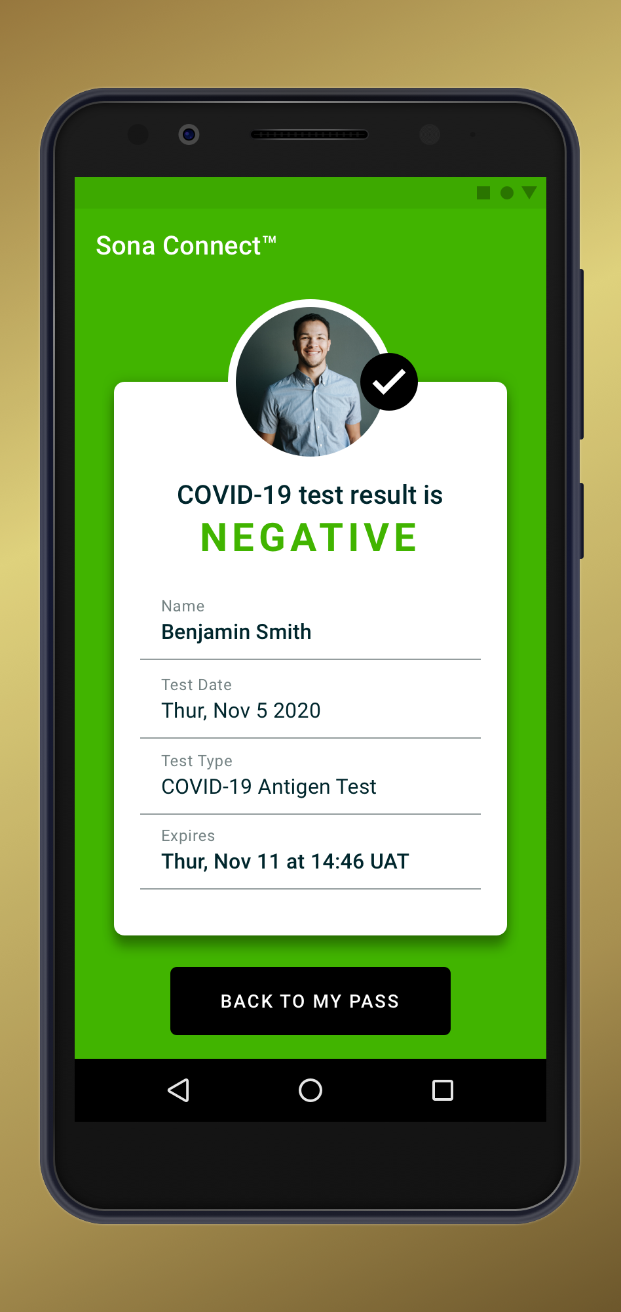
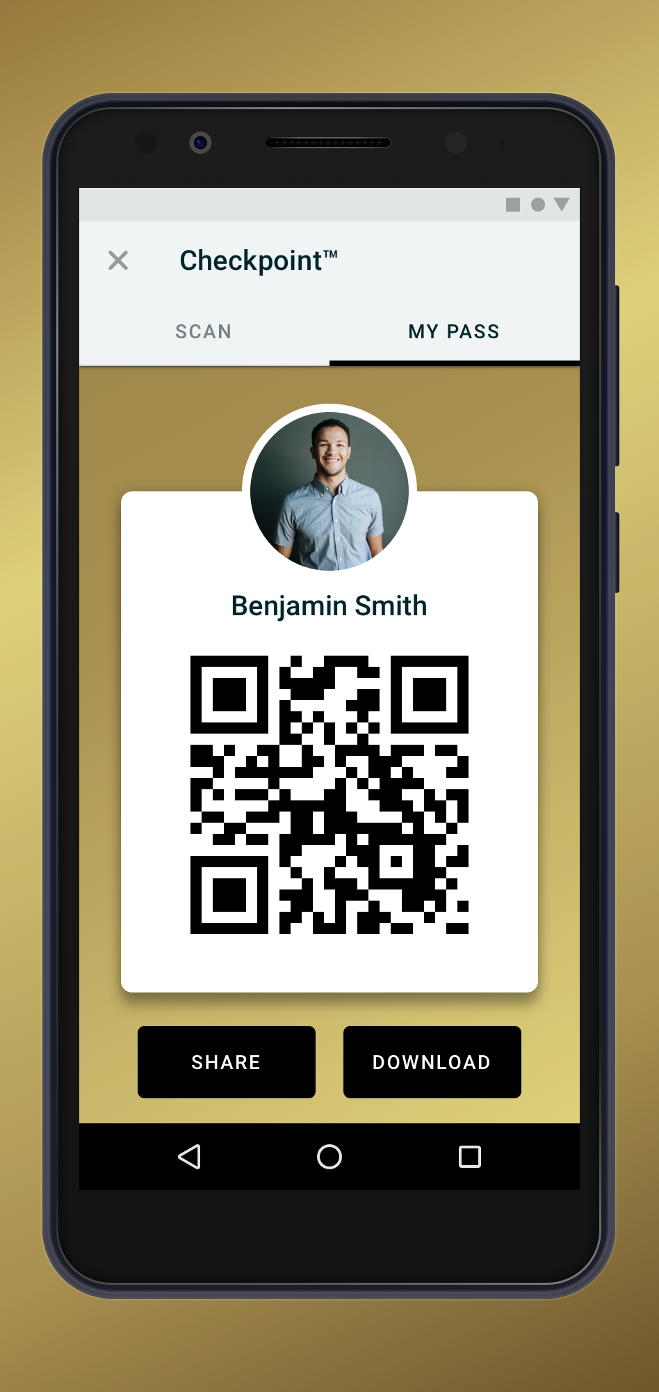
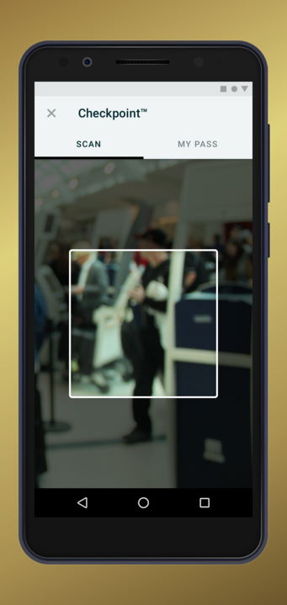
Android / iOS App Interface
Generate “Checkpoint” QR pass code with test result & photo identification.

Slide 6
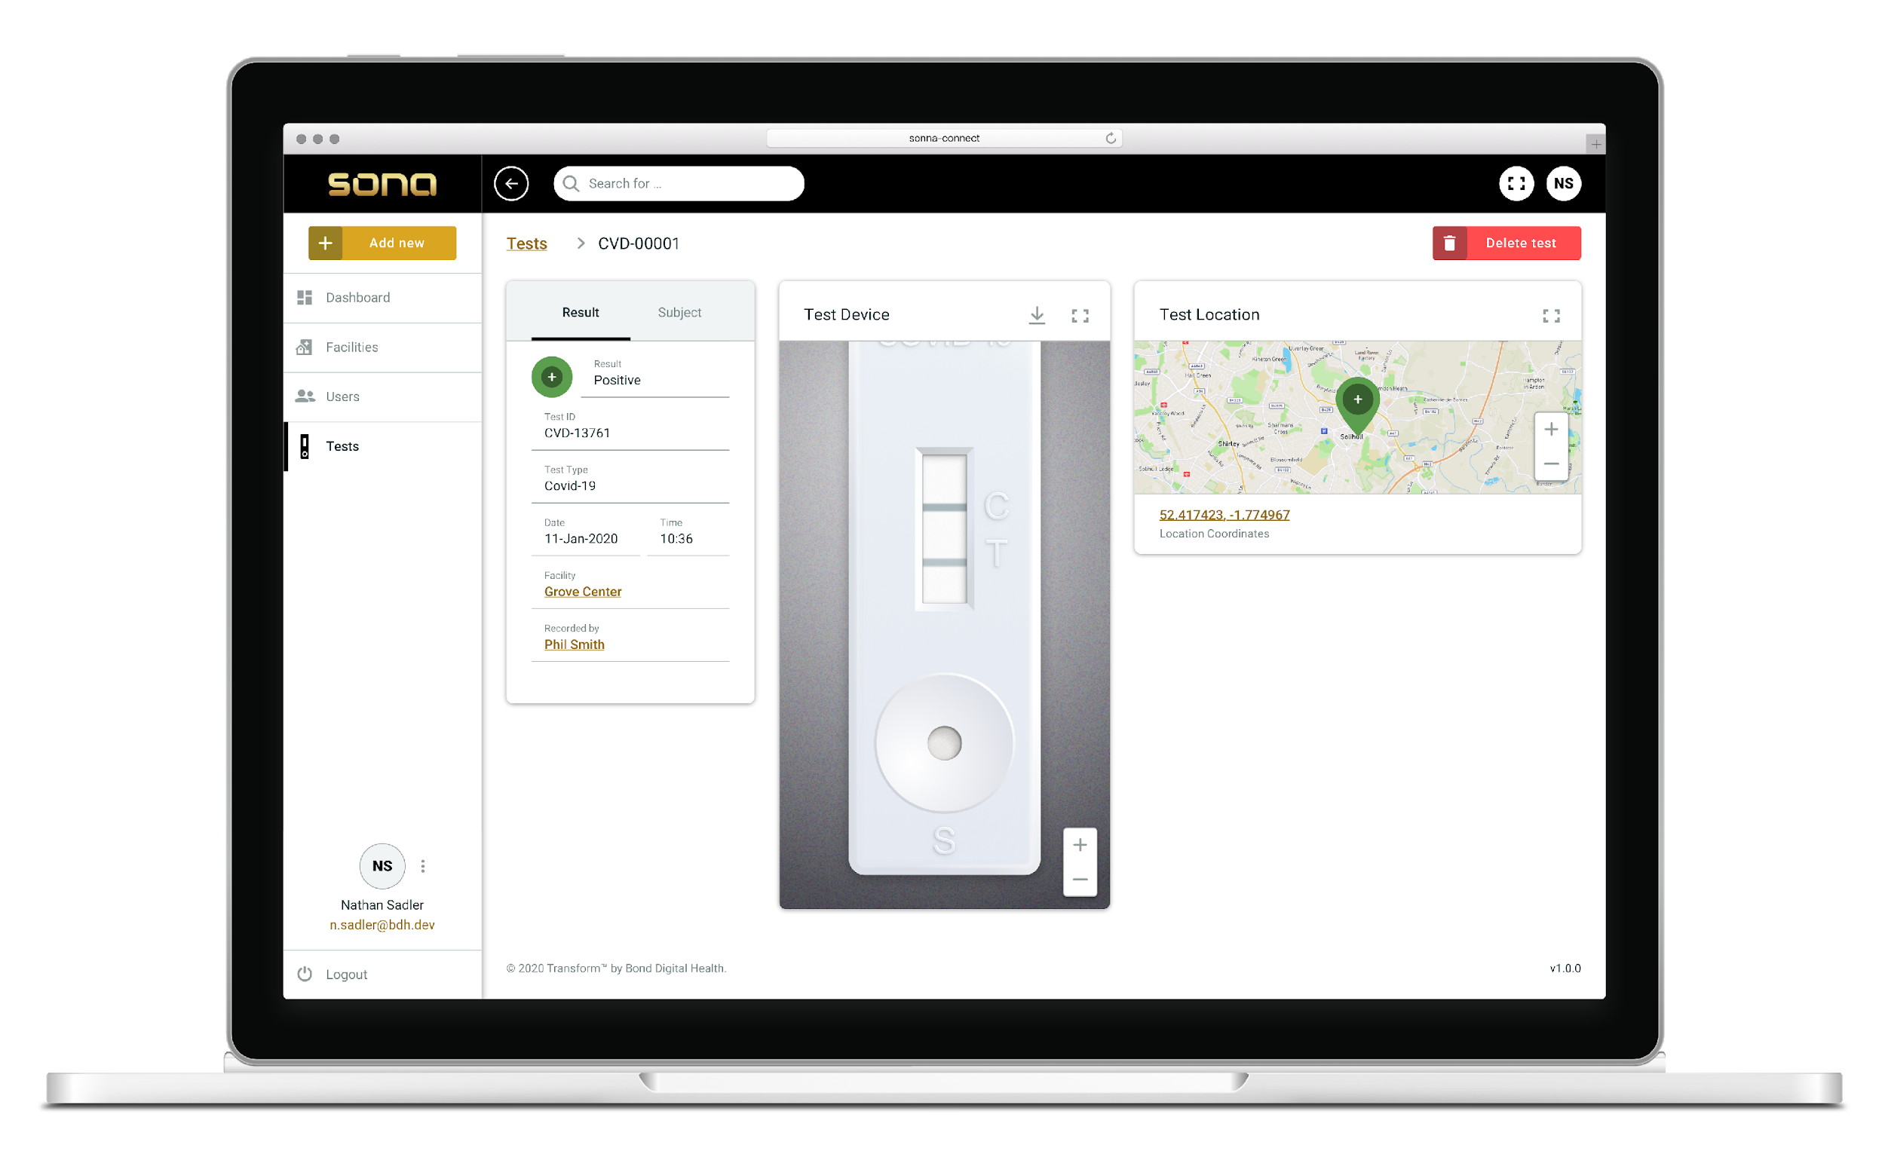
Dashboard Interface with test result

Slide 7
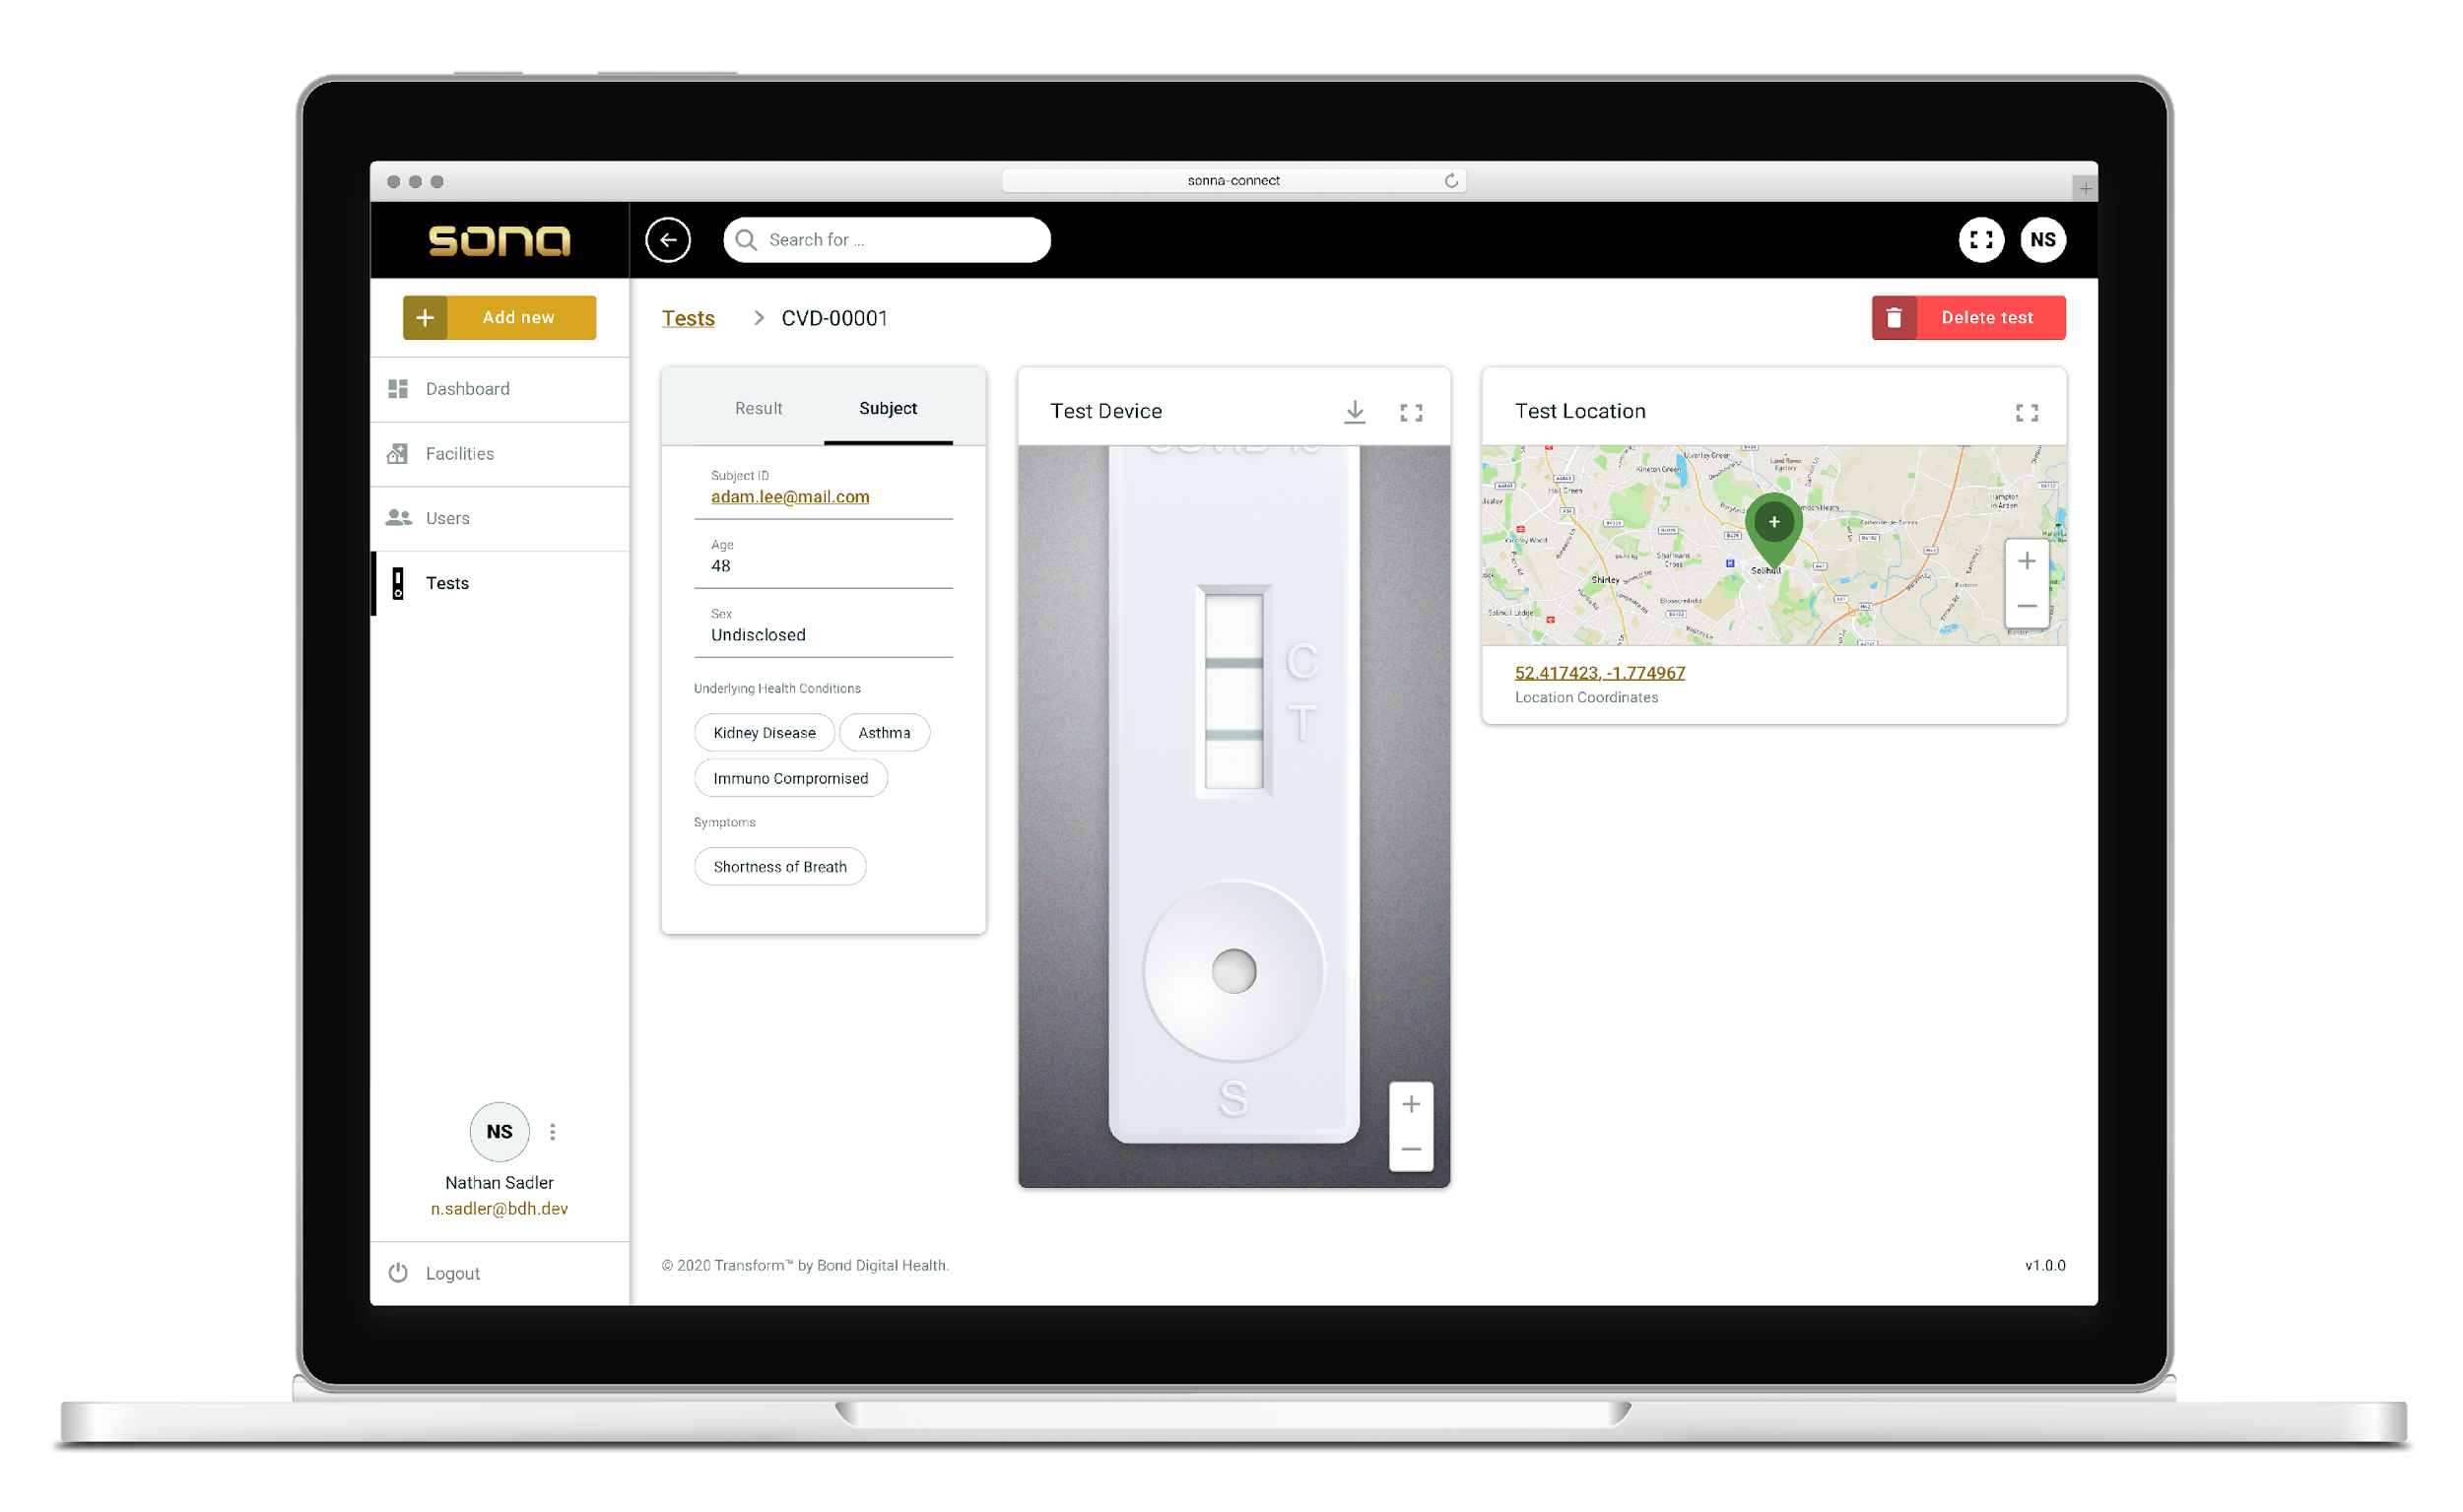
Dashboard Interface with epidemiolocal data

Slide 8
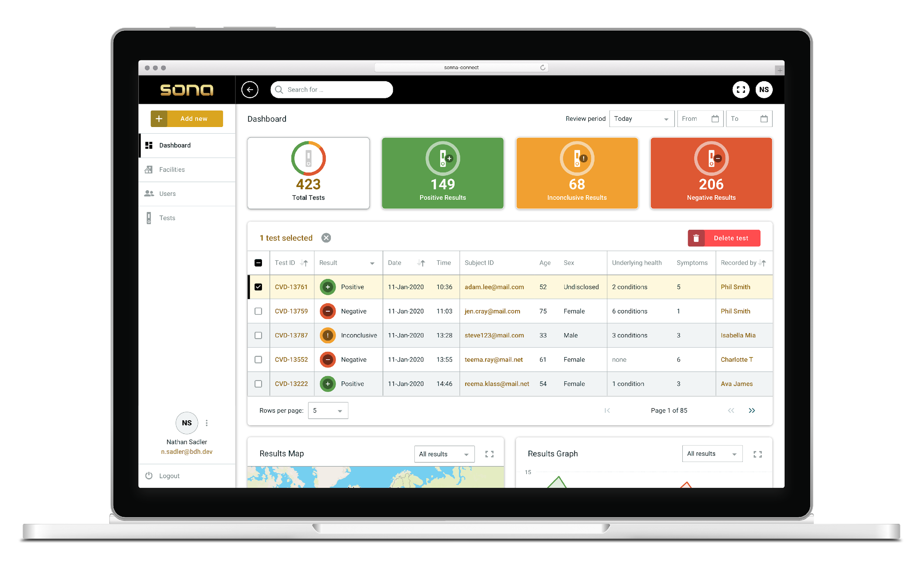
Dashboard Interface with result list & geo-maps

Slide 9
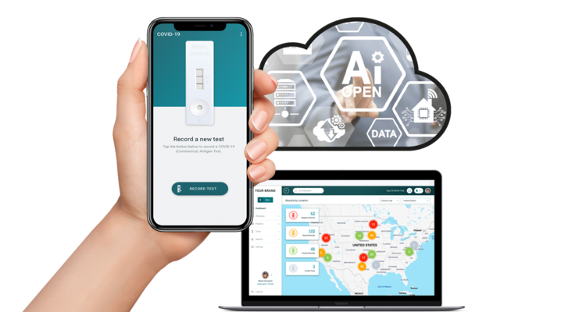
For further information regarding TRANSFORM® please contact Phil Groom - Commercial Director at Bond Digital Health Ltd
Tel +00 44 7967 018286 phil.groom@bondhealth.co.uk
Bond Digital Health
The Maltings
East Tyndall Street
Cardiff, UK.
CF24 5EA
www.bondhealth.co.uk

